Slide 1
E-Tendering and E-Auction
What is E-Tendering
Objectives
Tendering Procedures
Submission Process
Evaluation
Agreement

Slide 2
What is E-Tendering
The E-tendering approach leverages Commercial-Off-The-Shelf (COTS) software technology to facilitate collection of tenders from respondents.

Slide 3
E-Tendering
Principal tools:
Google Sites
Google Gmail - information sharing
Google Docs - electronic tender (e-tender) submission.
Technologies are robust and cost-effective
several areas of the e-tendering process require careful monitoring and control to ensure security, efficiency and propriety when collecting tenders.

Slide 4
Objectives
To facilitate the collection of tenders from respondents in a secure, efficient and ethical manner.

Slide 5
Objectives
Security of Information
Open
Fair
Transparent
Auditable
Easy to Use

Slide 6
Tendering Procedure
Request for approval to engage firms/contractors/consultants
CEO
Tenders Committee
Board of Commissioners

Slide 7
Types of Invitation
Public Invitation
Advertisements are published for Public tendering via channels:
WASA’s website http://www.wasa.gov.tt/WASA_Media.html
Local newspapers
Emailed to the List of Embassies
IDB Website
Selective Invitation
A Letter of Invitation (LOI) is prepared and emailed or
faxed to firms approved for a Selective process.

Slide 8
Bid Document and Tender Website
Tender Document is prepared and uploaded to the website
Pre-bid meetings and/or Site visits conducted as required
Live meetings.
All communications and questions from prospective bidders are received and answered via the Tender Website
At the end of the bidding period, firms must upload and share their bids online to wasacompliance@gmail.com and wasaombudsman@gmail.com by the deadline for submission.
A 2-part password ( Legal Rep and Procurement Rep) is utilized to maintain the integrity of the process.

Slide 9
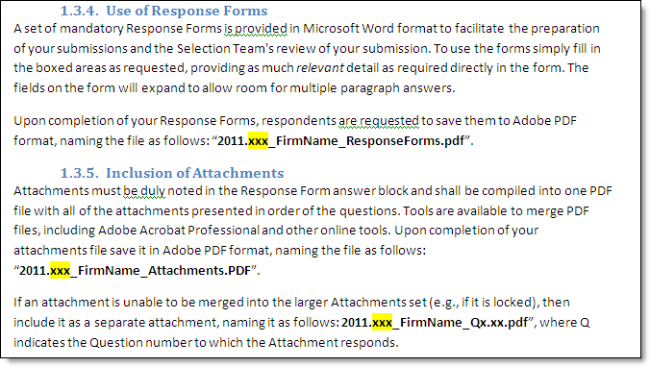
Submission Process
Respondent prepares submission in the format required All respondents are required to prepare their submissions in a specific way, using a particular file nomenclature, as outlined in the Instructions section of the Invitation (which may vary from these example instructions in the image to the left). The respondent’s response will likely include three or more files:
- Response Forms
- Addenda (may be separate attachments)
- Bill of Quantities (if required)

Slide 10
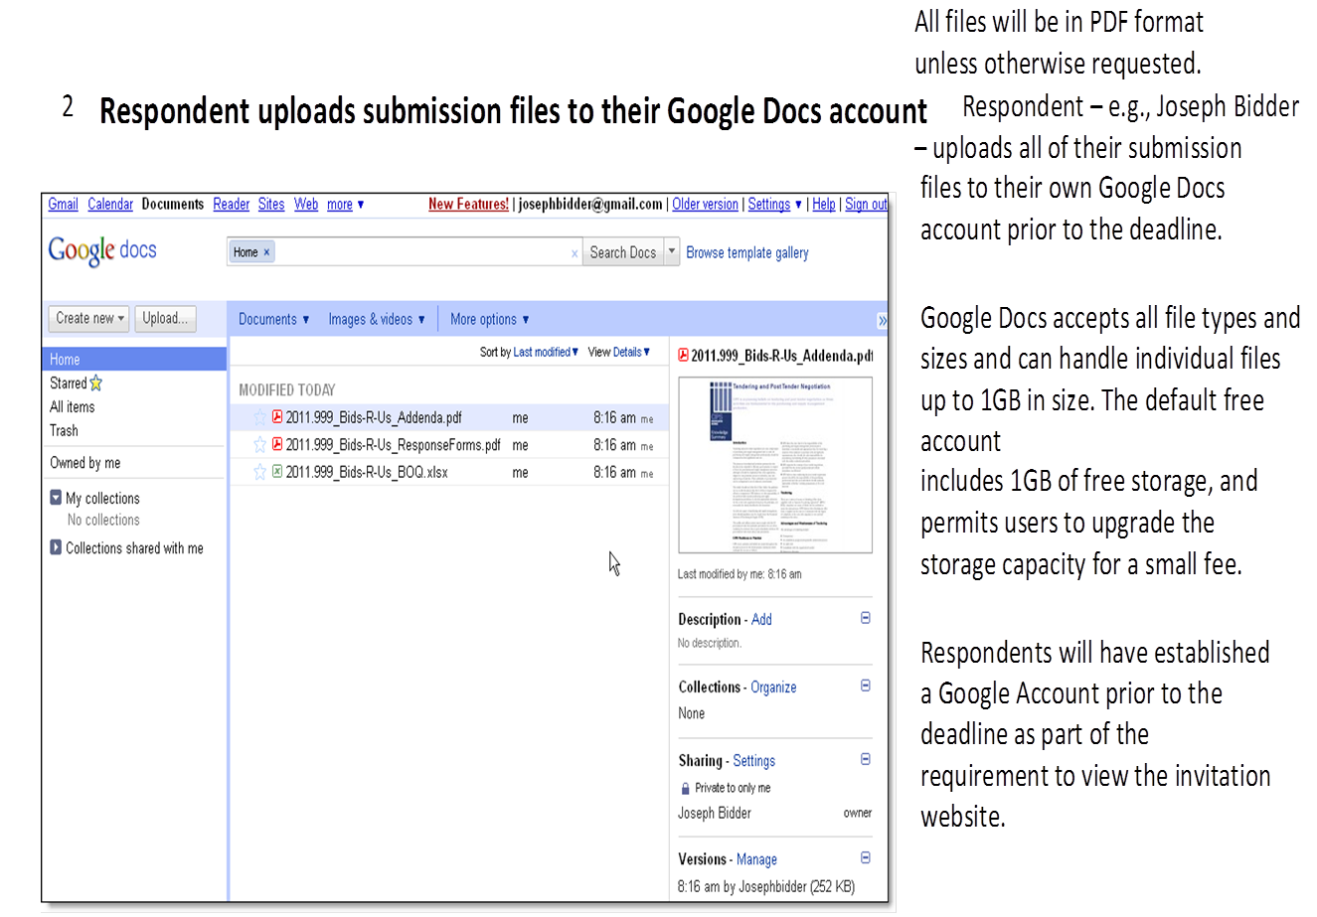
Submission Process

Slide 11
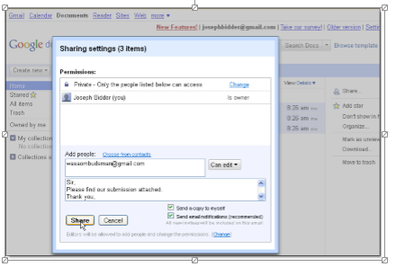
Submission Process
Respondent shares the files to the Authority using Google Docs | Respondent selects all of the files they wish to submit as part of their response and then clicks the ‘Share’ button to share them to the submissions email address noted in the invitation (e.g., wasacomplaince@gmail.com and wasaombudsman@gmail.com). Importantly, the vendor must: 1. select all of the files they wish to include in their response; 2. check both ‘Send a copy to myself’ and ‘Send email notification (recommended)’ 3. share the files so that the notification email is received prior to the deadline. (It generally takes only seconds for an email to be received after pressing Share.)

Slide 12
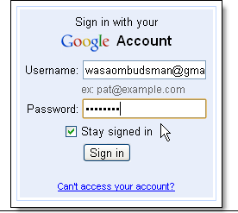
Submission Process

Slide 13
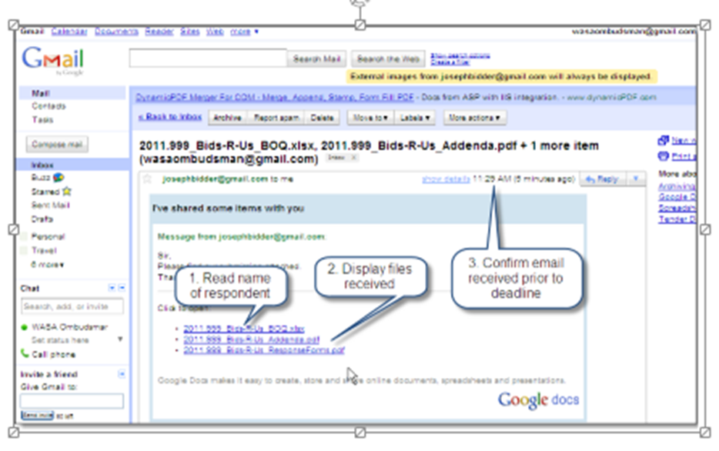
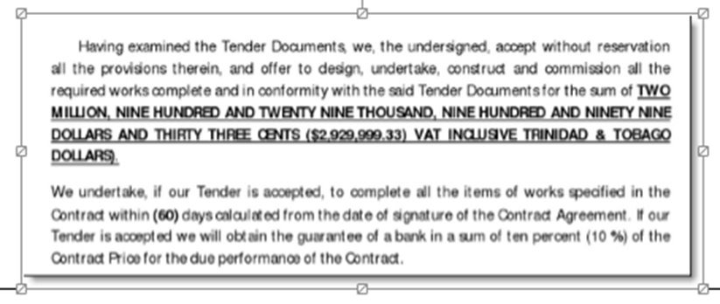
Submission Process

Slide 14
Closing of Bids and Evaluation
Respondents have 72-hours to submit any Compliance documents that were omitted. ( Vat, Income Tax, Financial
All bidders are notified via the website of all bid prices submitted after the 72 hour period.
A cross functional Evaluation Team comprising representatives from Procurement, User Department, Legal and Finance along with an independent Chairman.
Electronic bid submissions are evaluated
Recommendations are submitted, to the same body that approved invitations, for approval to award a contract(s).
Approval to award is communicated

Slide 15
Award and Agreement
Letter (s) Of Award
Performance Security
Contract Agreement
Purchase Order

Slide 16
E-AUCTION PROCESS

Slide 17
E-AUCTION PROCESS
An e-Auction is an online bidding process. The form commonly utilized by the Authority is a reverse Auction as the intent is to drive prices down (as opposed to up as is the case in traditional auctions).

Slide 18
Pre-requisites for an E-Auction
Robust specifications from the user department
Available funding for the proposed spend
Accurate Authority’s estimate
Supplier training on the how to use the procurement tool

Slide 19
E-AUCTION PROCESS

Slide 20
E-AUCTION PROCESS
A member of the Procurement Department through the E-Auction facilitator (Oracle) builds the event.
Sets parameters for the event
Parameters include pre-bid and bid dates, Authority’s estimate and overtime rules.

Slide 21
E - AUCTION - ONLINE BIDDING PROCESS
The Overtime is a setting whereby if either the first, second or third placed contractor places a bid within the last three minutes of the event, the timing of the event will be extended by a further three minutes.

Slide 22
E - AUCTION - ONLINE BIDDING PROCESS
A soft copy of the bidding document is converted to PDF format and uploaded to the event.
Interested contractor must first pay the bidding document fee for the tender.
Then the Contractor will be uploaded to the “event”.
A link will be sent to the contractor indicating that they have been invited to an e-Auction event.

Slide 23
E - AUCTION - ONLINE BIDDING PROCESS

Slide 24
E - AUCTION - ONLINE BIDDING PROCESS

Slide 25
E - AUCTION - ONLINE BIDDING PROCESS
Representatives from Procurement monitor the event to identify and respond to any improprieties during the course of the event.
The use of cell phones is prohibited and no one is allowed to exit the room.
Screen shots are taken periodically to record event details

Slide 26
E - AUCTION - ONLINE BIDDING PROCESS
Three working days after the event contractors are required to submit “hard copies” of their bid. The price submitted in the hard copy must correspond with the last price submitted by the firm at the close of the Auction.

Slide 27
E - AUCTION - ONLINE BIDDING PROCESS

Slide 28
E-Auction savings 2006
Pipes And Fittings
Chemicals (Liquid Aluminium Sulphate)
Computers
Total Savings - TT$23 Million (Four events)

Slide 29
E-Auction savings 2008

Slide 30
E-Auction savings 2009
Refurbishment works, wire wall fence,
Safety footwear, meters and accessories
Printers, Cisco smart systems, kiosk
Switches, relocations, actuators, pumps & fittings
Consultancy services, security services
Total Savings TT$13 Million (26 events)

Slide 31
E-Auction savings 2010
Bottle Mounted Chlorinators
Pipes and Fittings
Sewer Mains , Storage Tanks
Construction of Offices, Emergency Exits
Forklifts, Crane, Boom Truck
Pumps, Wire Wall Fences
Air-conditioning Unit
Total Savings TT$27 Million (sixteen events)

Slide 32
E-Auction savings 2011
Butterfly Valves
Self–priming Centrifugal Pumps And Motors
Design And Construction Of An Emergency Exit At Wasa Kew Place, Port Of Spain
Submersible Motors For Well Installations Throughout Trinidad
Supply And Installation Of New Lighting Systems
Total Savings TT$ 1.5 Million (9 events)

Slide 33
E-Auction savings 2012
Refurbishment Works at Chaguaramas Waste Water Facility
Purchase of two Vertical Line Shaft Pump sets for the El Socorro High lift Station
Refurbishment of the Endeavour Trucking Facility, Chaguanas
Procurement and Delivery of Ductile Iron, Steel and PVC Pipes and Fittings Via E-auction
Total Savings TT$ 98 Million (8 events)

Slide 34
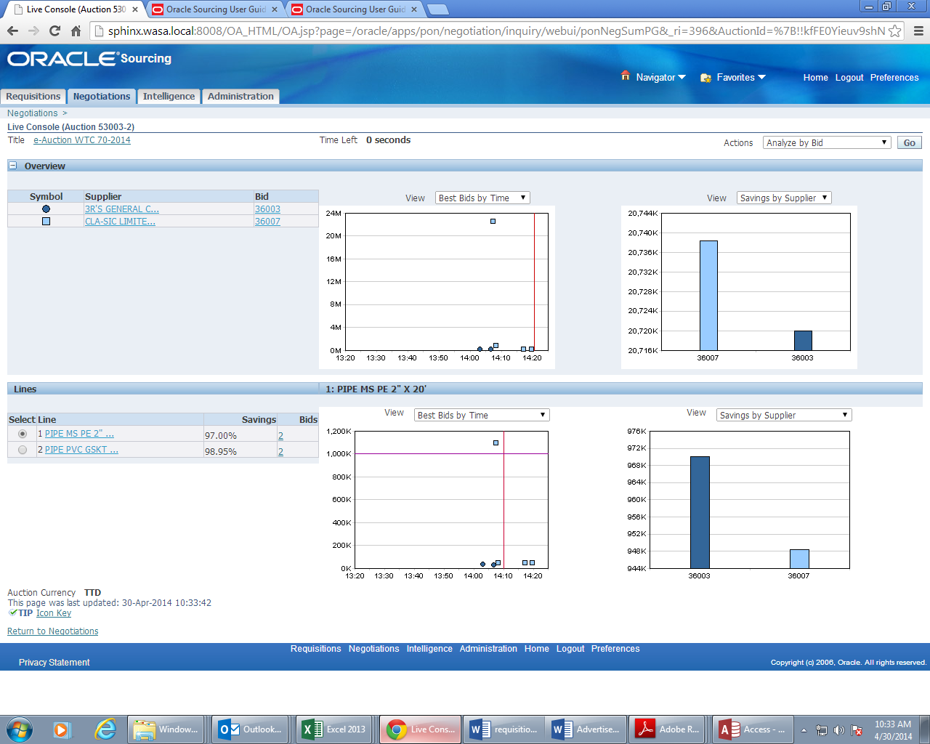
Live Auction View

Slide 35
E- Procurement E- Auction
THANK YOU

