Slide 1
Procurement capacity building: how to put it in place
Dr. Clifford McCue
June 23, 2014
Trinidad

Slide 2
How did you get here today?
Is there anyone in this room who decided at an early age that you wanted to buy office supplies for government as your chosen profession?
Or did you think about being a professional, such as a lawyer, doctor, engineer, or accountant?

Slide 3
How did you get here today?
Your current procurement position
From another agency
From the private sector
Could not find a better job

Slide 4
How did you get here today?
How many of you have a college degree?
How many of you have a college degree in public procurement?
Now the real question, how many of you currently think that public procurement is a worthy profession?

Slide 5
How is Public Procurement seen by others?
A clerical function.
Focused on red-tape (rule driven)
Stakeholders do not understand the value of good public procurement
Too bureaucratic
Is not linked directly to good governance
People who work in public procurement are inflexible and hate their jobs.

Slide 6
So what is the value of good public procurement?
It is amazing that roughly 12 – 15% of any nations GDP is controlled by public procurement, yet little is done to increase the capacity of those charged with spending government resources.

Slide 7
What is the value of good procurement?
The proﬁt-leverage effect:
An organization with revenue of $100 mil­lion, purchases of $60 million, and proﬁt of $8 million before tax, a 10 percent reduction in purchase spend would result in an increase in proﬁt of 75 percent, giving a leverage of 7.5. To achieve a $6,000,000 increase in proﬁt by increasing sales, assuming the same per­centage hold, might well require an increase of $75 million in sales, or 75 percent! Which of these two options—an increase in sales of $75 million or a reduction in procurement costs by 10% is the better option?

Slide 8
Today’s Overview
1
2
How do we build capacity?
3
Once you get there, then what?
What is Capacity Building in Public Procurement?
Notes:
This is another option for an Overview slide.

Slide 9
What is Capacity Building?
Notes:
Use a section header for each of the topics, so there is a clear transition to the audience.

Slide 10
What is Capacity Building?
According to the UNDP, capacity building takes place on an individual, institutional, and the societal level.
Individual level - Requires the development of conditions that allow individual participants to build and enhance existing knowledge, skills, and abilities to perform their jobs effectively.
Institutional level - It should not involve creating new institutions, rather modernizing existing institutions and supporting them in forming sound policies, organizational structures, and effective methods of management and revenue control.
Societal level - Community capacity building at the societal level should support the establishment of a more "interactive public administration that learns equally from its actions and from feedback it receives from the population at large." Community capacity building must be used to develop public administrators that are responsive and accountable.

Slide 11
9 Components of Capacity Building
Performance capacity: Are the tools, money, equipment, consumables, etc. available to do the job?
Personal capacity: Are the staff sufficiently knowledgeable, skilled and confident to perform properly? Do they need training, experience, or motivation? Are they deficient in technical skills, managerial skills, interpersonal skills, gender-sensitivity skills, or specific role-related skills?
Workload capacity: Are there enough staff with broad enough skills to cope with the workload? Are job descriptions practicable? Is skill mix appropriate?
Supervisory capacity: Are there reporting and monitoring systems in place? Are there clear lines of accountability? Can supervisors physically monitor the staff under them? Are there effective incentives and sanctions available?
Facility capacity: Are training centers big enough, with the right staff in sufficient numbers? Are there enough offices, workshops and warehouses to support the workload?
Support service capacity: Are there training institutions, supply organizations, building services, administrative staff, research facilities, quality control services?
Systems capacity: Do the flows of information, money and managerial decisions function in a timely and effective manner? Can purchases be made without lengthy delays for authorization? Are proper filing and information systems in use?
Structural capacity: Are there decision-making forums where inter-sector discussion may occur and decisions made, records kept and individuals called to account for non-performance?
Role capacity: This applies to individuals, to teams and to structure such as committees. Have they been given the authority and responsibility to make the decisions essential to effective performance, whether regarding schedules, money, staff appointments?
Source: Potter & Brough 2004

Slide 12
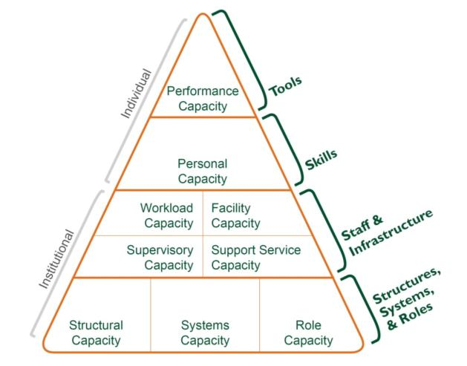
Capacity Building Framework
Potter, C., and R. Brough. 2004. Systemic Capacity Building: A Hierarchy of Needs. Health Policy and Planning. 19(5): 336-345.

Slide 13
How do we Build Capacity in Public Procurement?

Slide 14
How to Build Capacity in Public Procurement
Job Analysis
Gap Analysis
Development Plans

Slide 15
Building Capacity in Public Procurement
Job Analysis: Is a systematic process for collecting data on the knowledge, skills and ability to perform a job effectively.
Gap Analysis: Is a process which compares actual organizational performance to expected performance to determine whether it is meeting expectations and using its resources effectively. Gap analysis seeks to answer the questions "where are we?" (current state) and "where do we want to be?" (target state).
Development Plans: An individual development plan (IDP) is a tool to assist employees in career and personal development. Its primary purpose is to help employees reach short and long-term career goals, as well as improve current job performance.

Slide 16
Now that we are building capacity, where are we headed?

Slide 17
Where is Public Procurement Headed?
Capacity Building
ProcurementProfession
Purchasing
Occupation
Complexity
Purchasing
Job
Time

Slide 18
Pillars of a Profession
A Profession
Body of Knowledge (BOK)
Degree Programs
Certification and License to Practice
Professional and Learned Societies

Slide 19
Pillars of a Profession
A Profession
Common Language, Best Practices, Standards, Research, Trends
Curriculum Adoption, Internships
Barriers to Entry
Professional Certifications and Regulated Licensure
Content Management, Networks, Shared Knowledge, Standards Setting

Slide 20
Public Procurement As a Profession
Public Procurement
Public Procurement Body of Knowledge (PPBOK)
Public Procurement Curriculum
Public Procurement Professional Certifications and Organizational Accreditations
Associations Serving the Public Procurement Community

Slide 21
Pathways To Building The Profession
PPBOK
University Degrees
Licenses and Certifications
Professional and Learned Societies

Slide 22
Deliverables
Practices, Research, Standards, Language
Higher Ed Curriculum Adoption
Professional Development, Training, Resources, Consultancy
Professional Certifications and Organizational Accreditations

Slide 23
Benefactors
PPBOK
Institutions, Students, Internship Programs, Aspiring Managers, Public Agencies
Professionals, Emerging Governments, Public Agencies, NGOs, Donor Funded Organizations, Researchers, Consultants
Professionals, Emerging Governments, Public Agencies, NGOs, Donor Funded Organizations

Slide 24
One Day!
I can envision in the near future when a young person decides that they want to become a Public Procurement Professional rather than a lawyer, engineer, accountant, or a doctor.

Slide 25
Questions?

