Slide 1
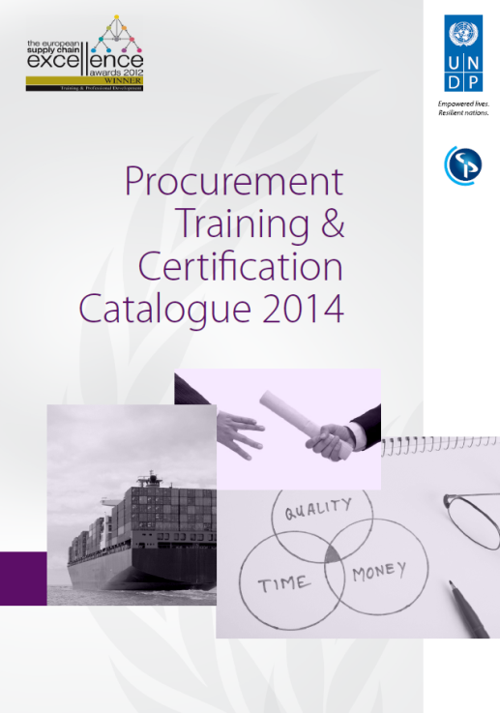

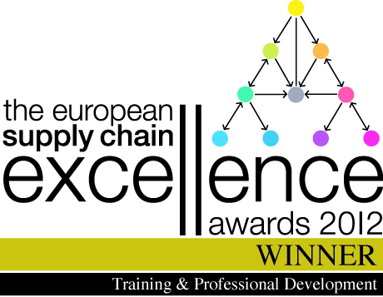
Procurement Certification – Who needs it?
United Nations Development Programme
In Cooperation with The Chartered Institute of Purchasing & Supply (CIPS)

Slide 2

What is UNDP?
UNDP is the UN’s global development network,
promoting Empowered lives. Resilient nations.
On the ground in 170 countries – total 2013 expenditure
of US$ 5.57 billion
Four focus areas: poverty reduction; democratic governance; crisis prevention and recovery; energy and environment
UNDP partners with people at all levels of society to help empower lives and build resilient nations.
Notes:
Advocating for change
Connecting countries to knowledge, experience and resources
Helping people build a better life

Slide 3

Why procurement certification?
Massive growth in procurement volume
  Increased 4 times in 5 years
  Sustained at $2.8 - 3.0 billion per year
Increased risk and complexity
  From (mainly) buying goods...
  ...to procuring services and civil works
Procurement capacity gabs
  No formal qualification system – so far
  New skill-sets and competencies required

Slide 4

Procurement Certification
Special Category: Professional Development and Training
United Nations Development Programme

Slide 5
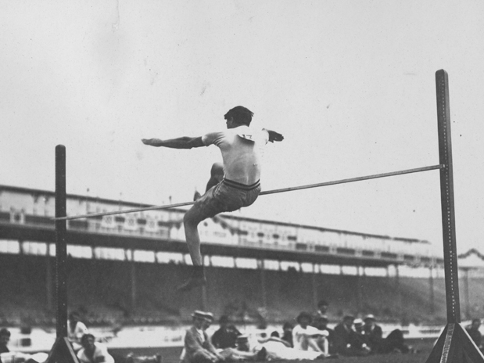
”Scissors” or ”straddle” high jumping

Slide 6
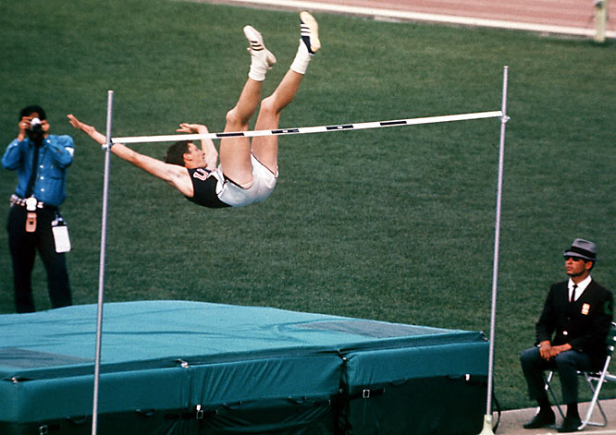
”Fosbury Flop”
Notes:
The madrass was the real new invention, enabling to jump higher than ever before. UNDP/CIPS want to provide the madrass for procurement staff to perform better!
Too tall for the high jump
Born on 6 March 1947 in Portland, Oregon (USA), from an early age Richard Douglas Fosbury showed a natural flare for science and mathematics. He was also a gifted athlete, with a particular talent for the high jump. However, when he reached his teens, he found that, at 1.93m, he was already too tall to perform it effectively using either the traditional scissors jump or the more commonly used straddle technique. His personal best had plateaued at 1.80m, and so the young Fosbury realised that if he was to make further progress in the discipline, he would have to come up with a different approach.
A leap of faith
From 1963 onwards, Dick Fosbury started using a new technique of his own invention. Starting into a curved run-up, he turned away from the bar, transferring his weight and thrusting his body backwards over the bar. The young athlete used his new technique in a college tournament to record a jump of 2m, much to the bemusement of the judges, who, after much deliberation, were forced to conclude that Fosbury’s unorthodox but effective style was perfectly legitimate, since the only requirement is that a high jumper launches off one foot.
Making waves in Mexico
Having been chosen to represent the USA at the 1968 Olympic Games, thanks to a 2.21m jump during the American trials, Fosbury made it through to the final at Mexico City’s Olympic Stadium on 20 October 1968. His novel jumping style had the crowd gasping, as he cleared each new height at the first attempt, right up to 2.22m, by which point all of the other finalists had fallen by the wayside. It then took him three goes to succeed at 2.24m and set a new Olympic record. But the gold medal was not yet his. He faced an anxious wait as, once again, the judges debated whether his technique was in breach of any of the technical regulations. Eventually they decided it was not, and Fosbury was duly crowned Olympic champion.
Raising the bar
Fosbury’s exploits in Mexico instantly earned him national hero status back home. Meanwhile, the rest of the world was quick to recognise the effectiveness of his technique, which became more and more widely used, enabling athletes to clear heights in excess of 2.40m. Today, the Fosbury Flop is immortalised in the dictionary, and has been firmly established as the only technique used in the high jump.

Slide 7
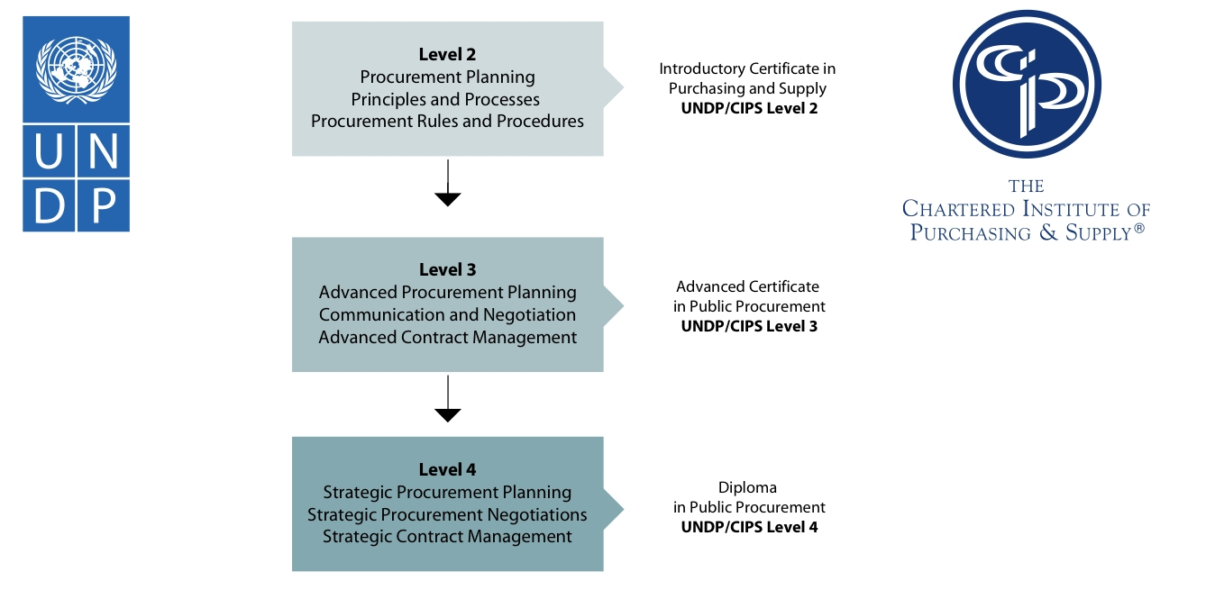

Procurement Certification structure
On-line modules through LRC
UNDP/CIPS Certificate
Level 2
UNDP/CIPS Advanced Certificate
Level 3
UNDP/CIPS Strategic Diploma
Level 4

Slide 8
Objectives
”The objective is to provide faster, economical and better customized procurement certification - reflecting public procurement procedures, policies, practises...”
Faster
Economical
Customised

Slide 9
Customisation process
UNDP/CIPS Accredited Procurement Certification Programme
- UN/Public Procurement Focus
Australian CIPS Accredited Public Procurement Certification Programme
- Public/Government Purchasing Focus
Chartered Institute of Purchasing & Supply
Private Sector Purchasing Focus
British/European Law
UN Procurement
Government Purchasing
Private Sector Purchasing

Slide 10
Allows for innovative assessment methods
1. Workbook
In-class assessment
Minimum score 80%
3. Work Based Assessment
Apply theory to case
8 weeks to complete
2. Multiple Choice Questions
In-class exercises
Marked by tutor
Compulsory
Pass/fail
Marked by tutor
Back-to-office
3500 word essay
Fail, Pass, Credit, Distinction
Pass/fail
Notes:
What helps us to drive down cost is that ONLY 3 exams are required, and two are in-class

Slide 11
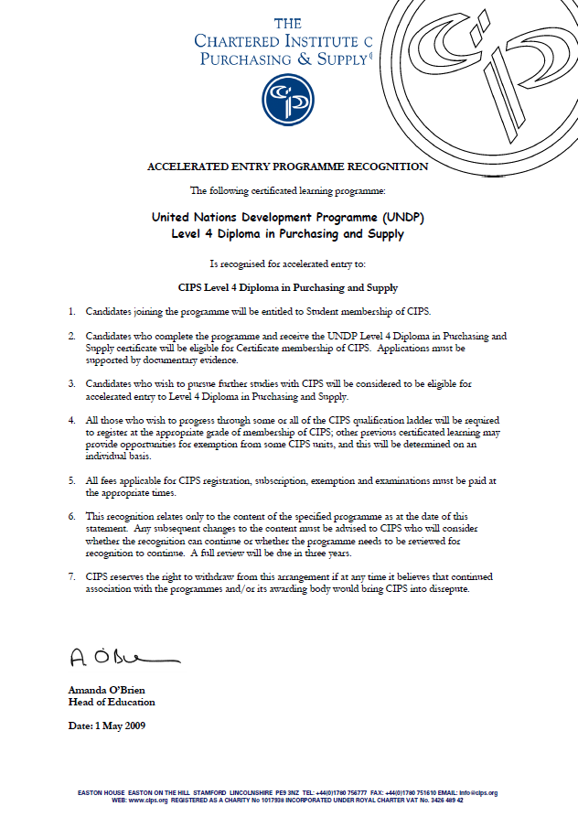
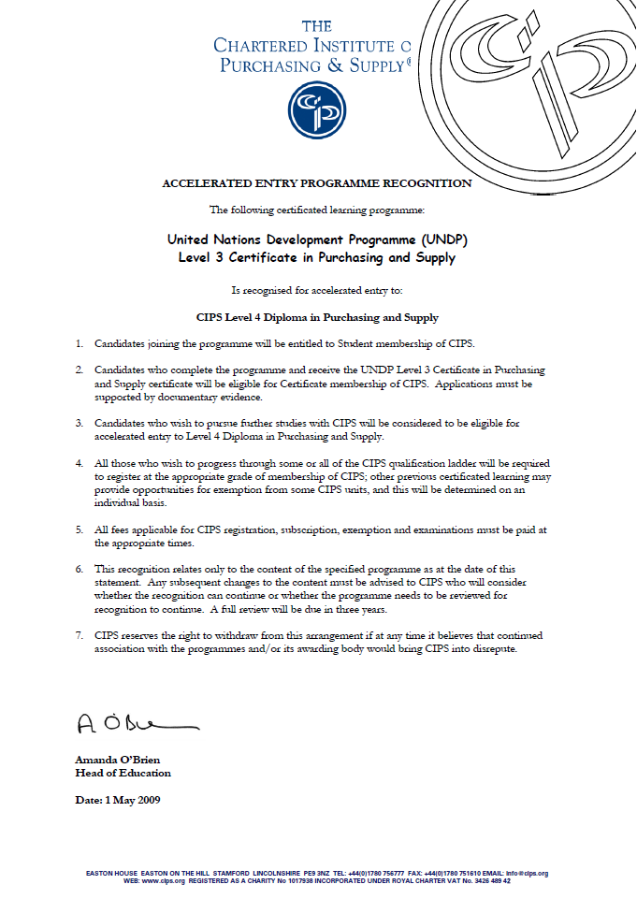
Procurement training vs. Certification?

Slide 12
Membership of a professional association
Certification | UNDP/CIPS Exit Awards | Corresponding CIPS Exit Awards | CIPS Membership Grade
Level 2 | Introductory Certificate in Public Procurement | Introductory Certificate in Purchasing and Supply | CIPS Student Member CIPS Certificate Member
Level 3 | Advanced Certificate in Public Procurement | Advanced Certificate in Purchasing an Supply | CIPS Certificate Member
Level 4 | Strategic Diploma in Public Procurement | Diploma in Purchasing and Supply | CIPS Diploma Member

Slide 13

What’s Next?
Impact of the Procurement Certification Programme
Special Category: Professional Development and Training
United Nations Development Programme

Slide 14

Creating a Procurement Profession
It is creating a cadre of professional procurement staff and career path
Link delegation of procurement authority to staff certification level(s)
Link job descriptions to certification levels (in cooperation with HR)
Establish a ”drivers license” for procurement recognised across organisations and locations

Slide 15


Major Impacts & Improvements
Enabler of a harmonised approach: Facilitates ”One UN” Procurement Reform
Transforming procurement from compliance based to a modern strategic/value adding business service function!
Changed training from a ”reward” for good performance to a ”requirement” to practise!
Offers participants access to a worldwide community of procurement professionals

Slide 16
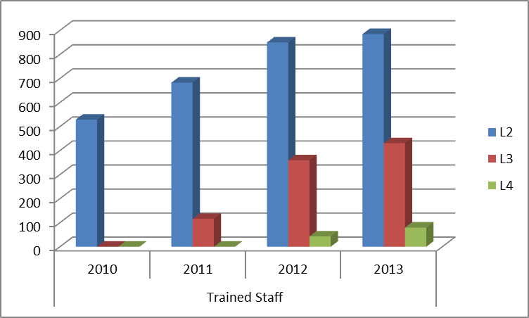
Demand is increasing for Procurement Certification

Slide 17










Users of Procurement Certification

Slide 18
Quotes from clients and users
”Procurement Certification has significantly improved the competencies and qualifications of procurement staff, and helped IAEA in its reform process towards full value chain integration in its purchase to pay processes” Christine Tonkin, Director, Procurement, International Atomic Energy Agency, Vienna
”UNWRA as an organisation has benefited tremendously from the quality of the UNDP/CIPS programme, and staff have embraced the qualifications provided through the certification programme with previously unseen enthusiasm”. Neil Ashcroft, Director, UNWRA

Slide 19
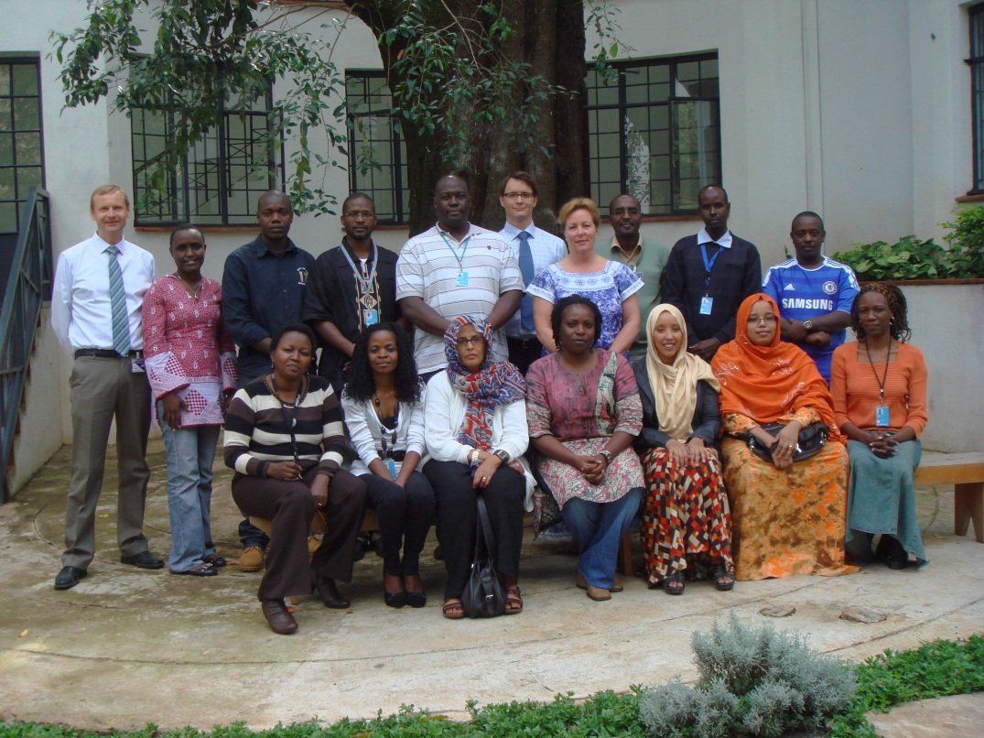
Case: Testimonials from UNDP Somalia
“I gained huge knowledge through this
Public procurement Level 3 course. Specifically, I comprehended that planning and considering risk at the earliest stages in procuring planning, together with other plans such as those for defining requirements, developing specifications and researching the market, a plan to identify, analyze evaluate and treat risk and allocate risk management responsibilities, also that Specification are central to our ability to carry out a purchase to the satisfaction of our clients, In addition, I understand well that the success of the purchase relies on the specification being a true and accurate statement of the client’s requirements”
“Personally, the specific modules that have great impact on me were the Negotiation and Communication Modules which we did some practical Role playing where we divided into two groups; one group was acting procurement officer whereas the other group was acting supplier and the rest of the team were watching and commenting what went well, what was the challenge what could have been done differently it was bit fun but we gained skill that will help us a lot, it is easy to remember things when you do it practically”

Slide 20


Key impacts Procurement Certification
Of the first 1000 certified staff the follow-up client satisfaction survey indicates:
85% have improved their performance post-certification (Level 2) in the areas of strategic approach, customer satisfaction, efficiency and effectiveness.
75% indicate that advancing to the Level 3 and Level 4 programmes will further enhance performance and customer satisfaction.

Slide 21
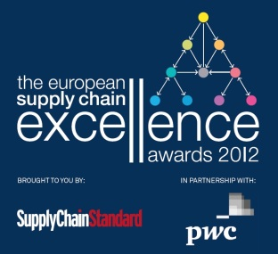
The European Supply Chain Award Winner 2012/13
UNDP and CIPS were awarded the prestigious European Supply Chain Excellence Award 2012/2013 for Training and Professional Development. This Award is in recognition of the Procurement Certification and Training Programme and its success in professionalizing the UN and public procurement sector.
Read more: www.supplychainexcellenceawards.com

Slide 22

More Information…?

Slide 23
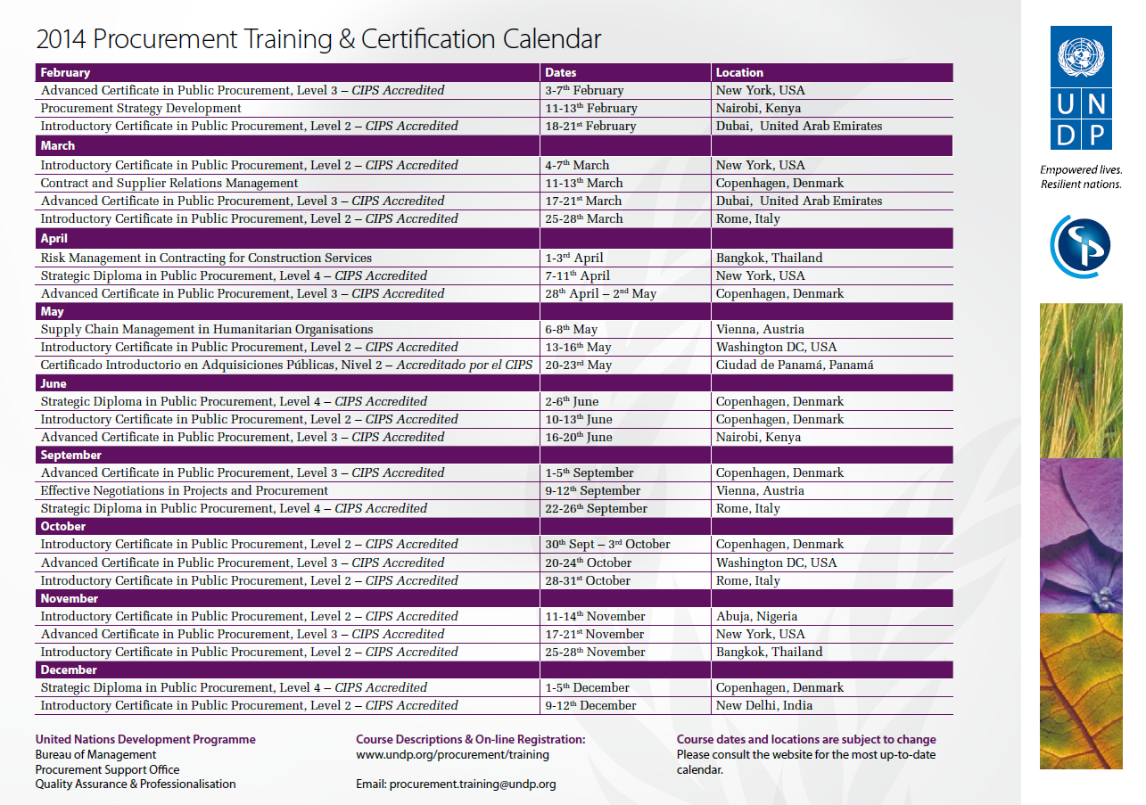

Slide 24
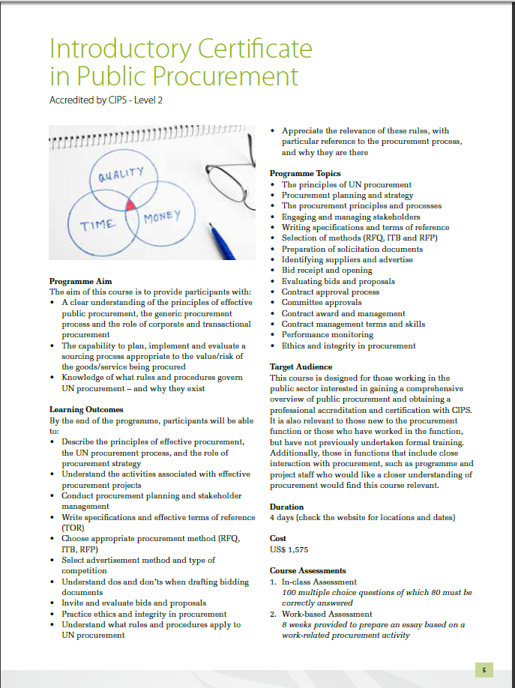
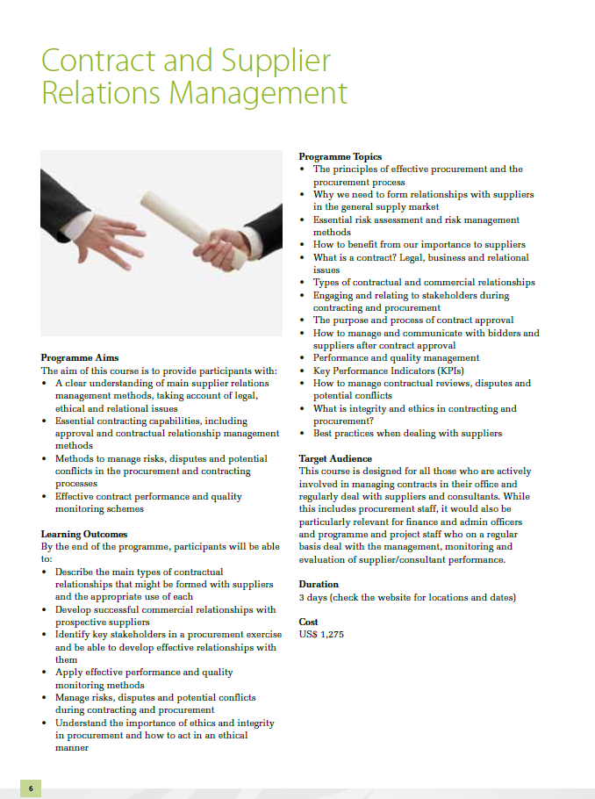
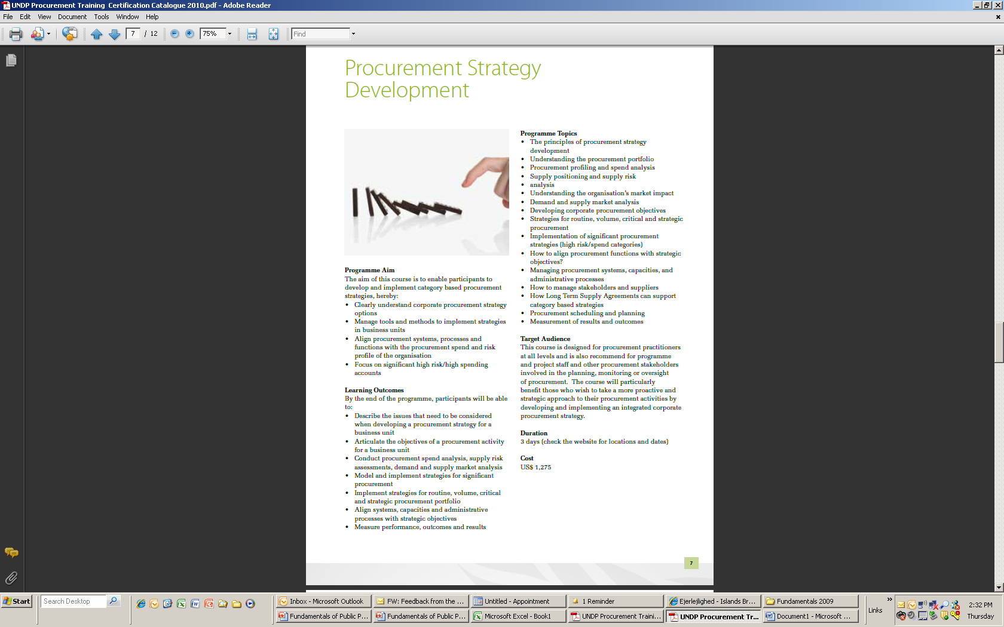
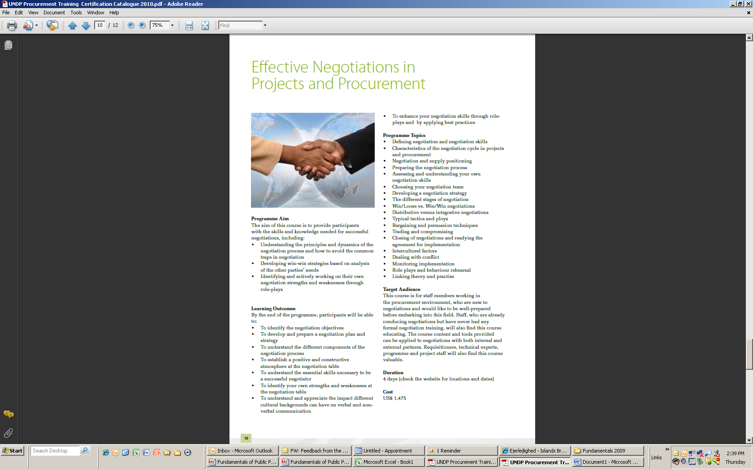
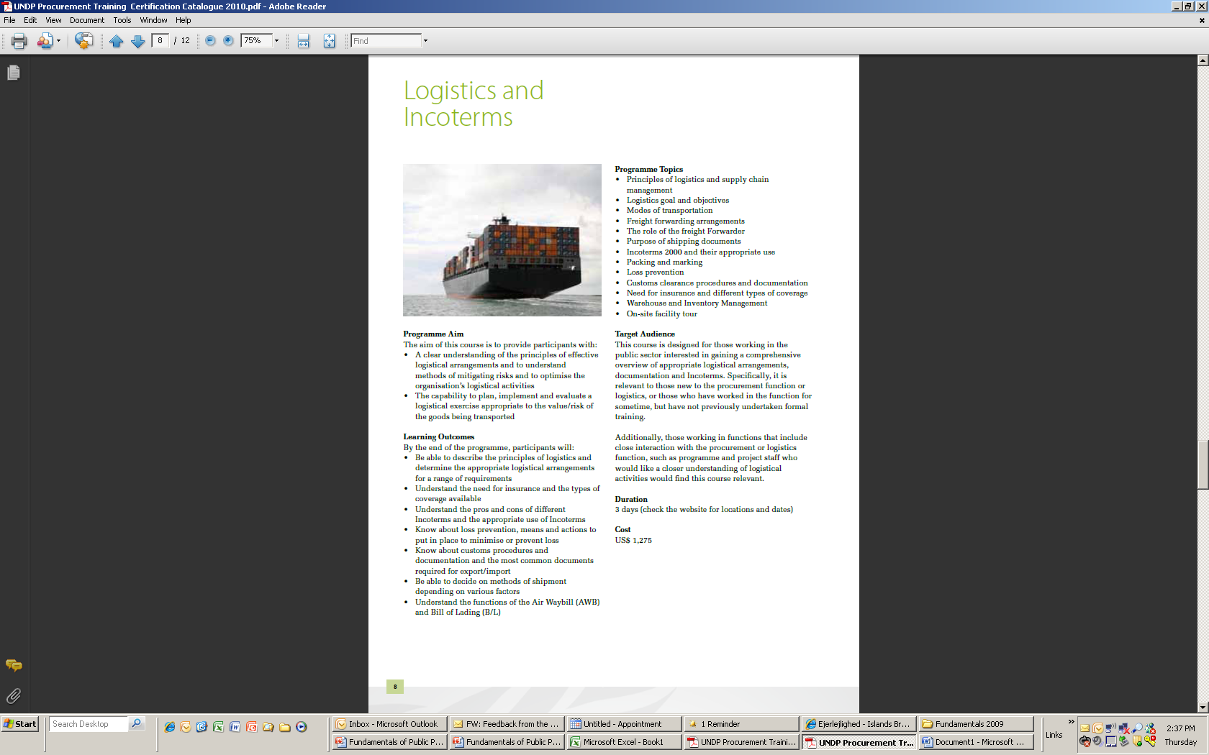
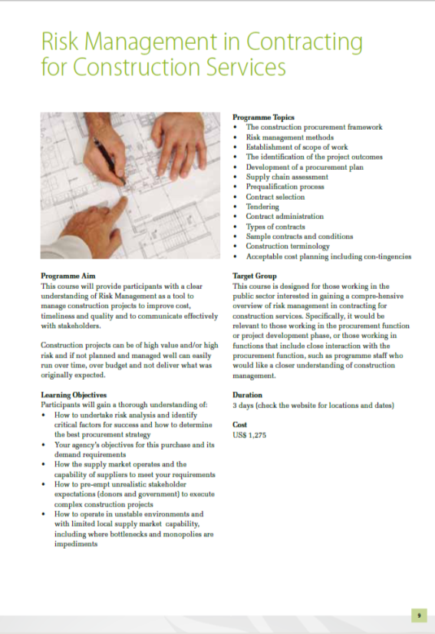
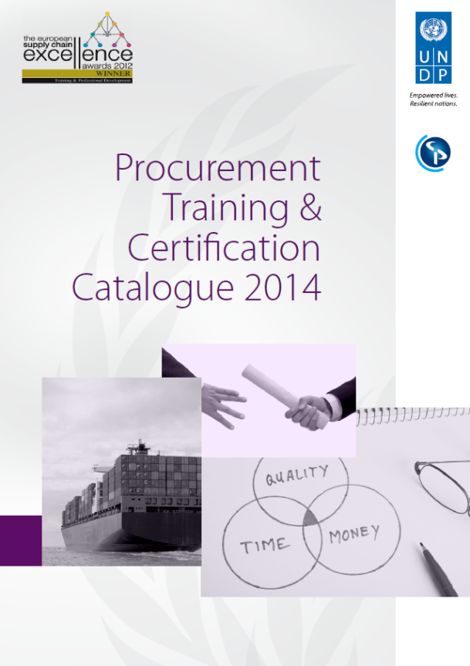
Download the 2014 training course catalogue here:
www.undp.org/procurement/training

Slide 25
What is the link to the “Fosbury Flop”?

Slide 26

To provide a “mattress” to help procurement practitioners to improve their performances….

Slide 27

Contact Details
Quality Assurance & Professionalisation Unit
Procurement Support Office
Bureau of Management
UNDP
Contact details:
marco.sosted@undp.org
procurement.training@undp.org
www.undp.org/procurement/training
Something

