Slide 1
Regional Conference on Public Procurement
June 23rd 2014
Port of Spain, Republic of Trinidad and Tobago
GOVERNMENT PROCUREMENT
FOR REGIONAL INTEGRATION
David McDermont
International Governance Solutions
david.mcdermont@intgov.com
www.intgov.com

Slide 2
International Governance Solutions
10 years in Strategic Government Procurement in WA, then Consultancies in over 35 countries since 2002:
e-procurement system assessment development and implementation (12)
e-GP assessments and Implementation Strategies (22)
Strategic procurement tools for the MDBs www.mdbegp.org
ICT infrastructure harmonisation and investment (9)
International e-Government Procurement surveys in Asia/Oceania, Europe, and South America (2)
Procurement training and organisation development (8)
Recent e-Procurement projects in Jamaica and the OECS

Slide 3
IGS Relevant Area Experience
Country | e-GP Assessment and Reform Plan | e-P System Plan & Implementation | Capacity Development | FAs & Reviews | Year
Barbados | X |  | X X | FAs, Legal | 2010-2014
Columbia | X | X | X |  | 2010 & 2014
Costa Rica |  |  |  | Legal | 2009
Dominican Republic | X |  | X | FAs | 2009
Guyana |  |  |  | Review | 2009
Jamaica | X | X | X | FAs | 2007-2014
Mexico | X | X | X | FAs, CPAR | 2007-2012
OECS (6) | X | X | X | FAs, Legal | 2010-2013
Panama | X |  |  | OECD-DAC | 2008
Peru | X |  |  | CPAR | 2008
Trinidad and Tobago |  |  |  | Reform Plan | 2011-2012

Slide 4
A Mature e-GP Environment
Systems
E-SYSTEMS
e-Tendering
Online Public Tendering
e-Purchasing
Online Purchasing /Auctions
B
U
S
I
N
E
S
S
G
O
V
E
R
N
M
E
N
T
e-Proc Mgt & Information
Online Contract Mgt and Information
Supporting Administrative Systems
Data Warehouse
Underlying Components of e-GP
Government Leadership, Human Resource Management,
Planning & Management, Policy, Legislation & Regulation Infrastructure & Web Services,
Standards, Private Sector Integration, Systems
Notes:
Single portal is effective and efficient. Could be replicated across countries. Allows centralised purchasing
Systems can not operate in isolation, must have the supporting components in place.
40 countries/states have implemented e-procurement and another 40 are in some phase of the planning/implementation process

Slide 5
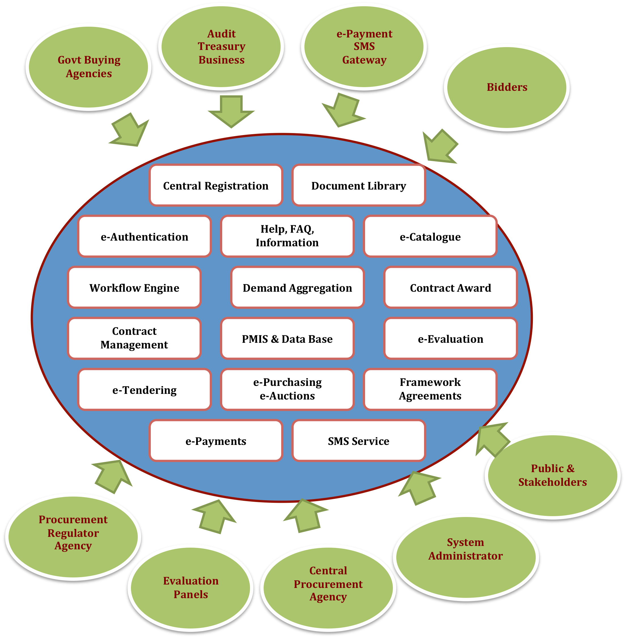
Example: e-Procurement System Functionality
Notes:
Time is right
At least 6 Caribbean countries ( Jamaica, Barbados and 4 in the OECS) are approaching the system specifications, acquisition and implementation stage for an e-procurement system. OECS harmonisation projects-e.g. e-procurement and e-enabling legislation (ensure all have same e-signature technology)
CARICOM is demonstrating that regional planning may work.
economic planning has made progress on Draft Framework Regional Integration Policy for Public Procurement June 2010. Covers principles, economic agreements, procurement procedures, institutional requirements and safeguards.
Associated e-Planning Strategies to harmonise ICT and e-Government harmonisation
CSME objective of free movement of goods and services will be assisted by a single e-procurement system. e.g. single item catalogue
CSME can not be achieved without regional government procurement.
Community and International Donor pressure building on governments to take action. Demand for better government services and accountability.
Significant benefits can be achieved

Slide 6
Example: e-P System Technical Structure
Web based, able to service web, mobile phones, email
Open standards and architecture to assist integration, extendibility and modularity
Robust security- unorthorised access, user roles, document integrity, file storage
Modular to assist staged implementation
Relational database
User friendly
Notes:
Time is right
At least 6 Caribbean countries ( Jamaica, Barbados and 4 in the OECS) are approaching the system specifications, acquisition and implementation stage for an e-procurement system. OECS harmonisation projects-e.g. e-procurement and e-enabling legislation (ensure all have same e-signature technology)
CARICOM is demonstrating that regional planning may work.
economic planning has made progress on Draft Framework Regional Integration Policy for Public Procurement June 2010. Covers principles, economic agreements, procurement procedures, institutional requirements and safeguards.
Associated e-Planning Strategies to harmonise ICT and e-Government harmonisation
CSME objective of free movement of goods and services will be assisted by a single e-procurement system. e.g. single item catalogue
CSME can not be achieved without regional government procurement.
Community and International Donor pressure building on governments to take action. Demand for better government services and accountability.
Significant benefits can be achieved

Slide 7
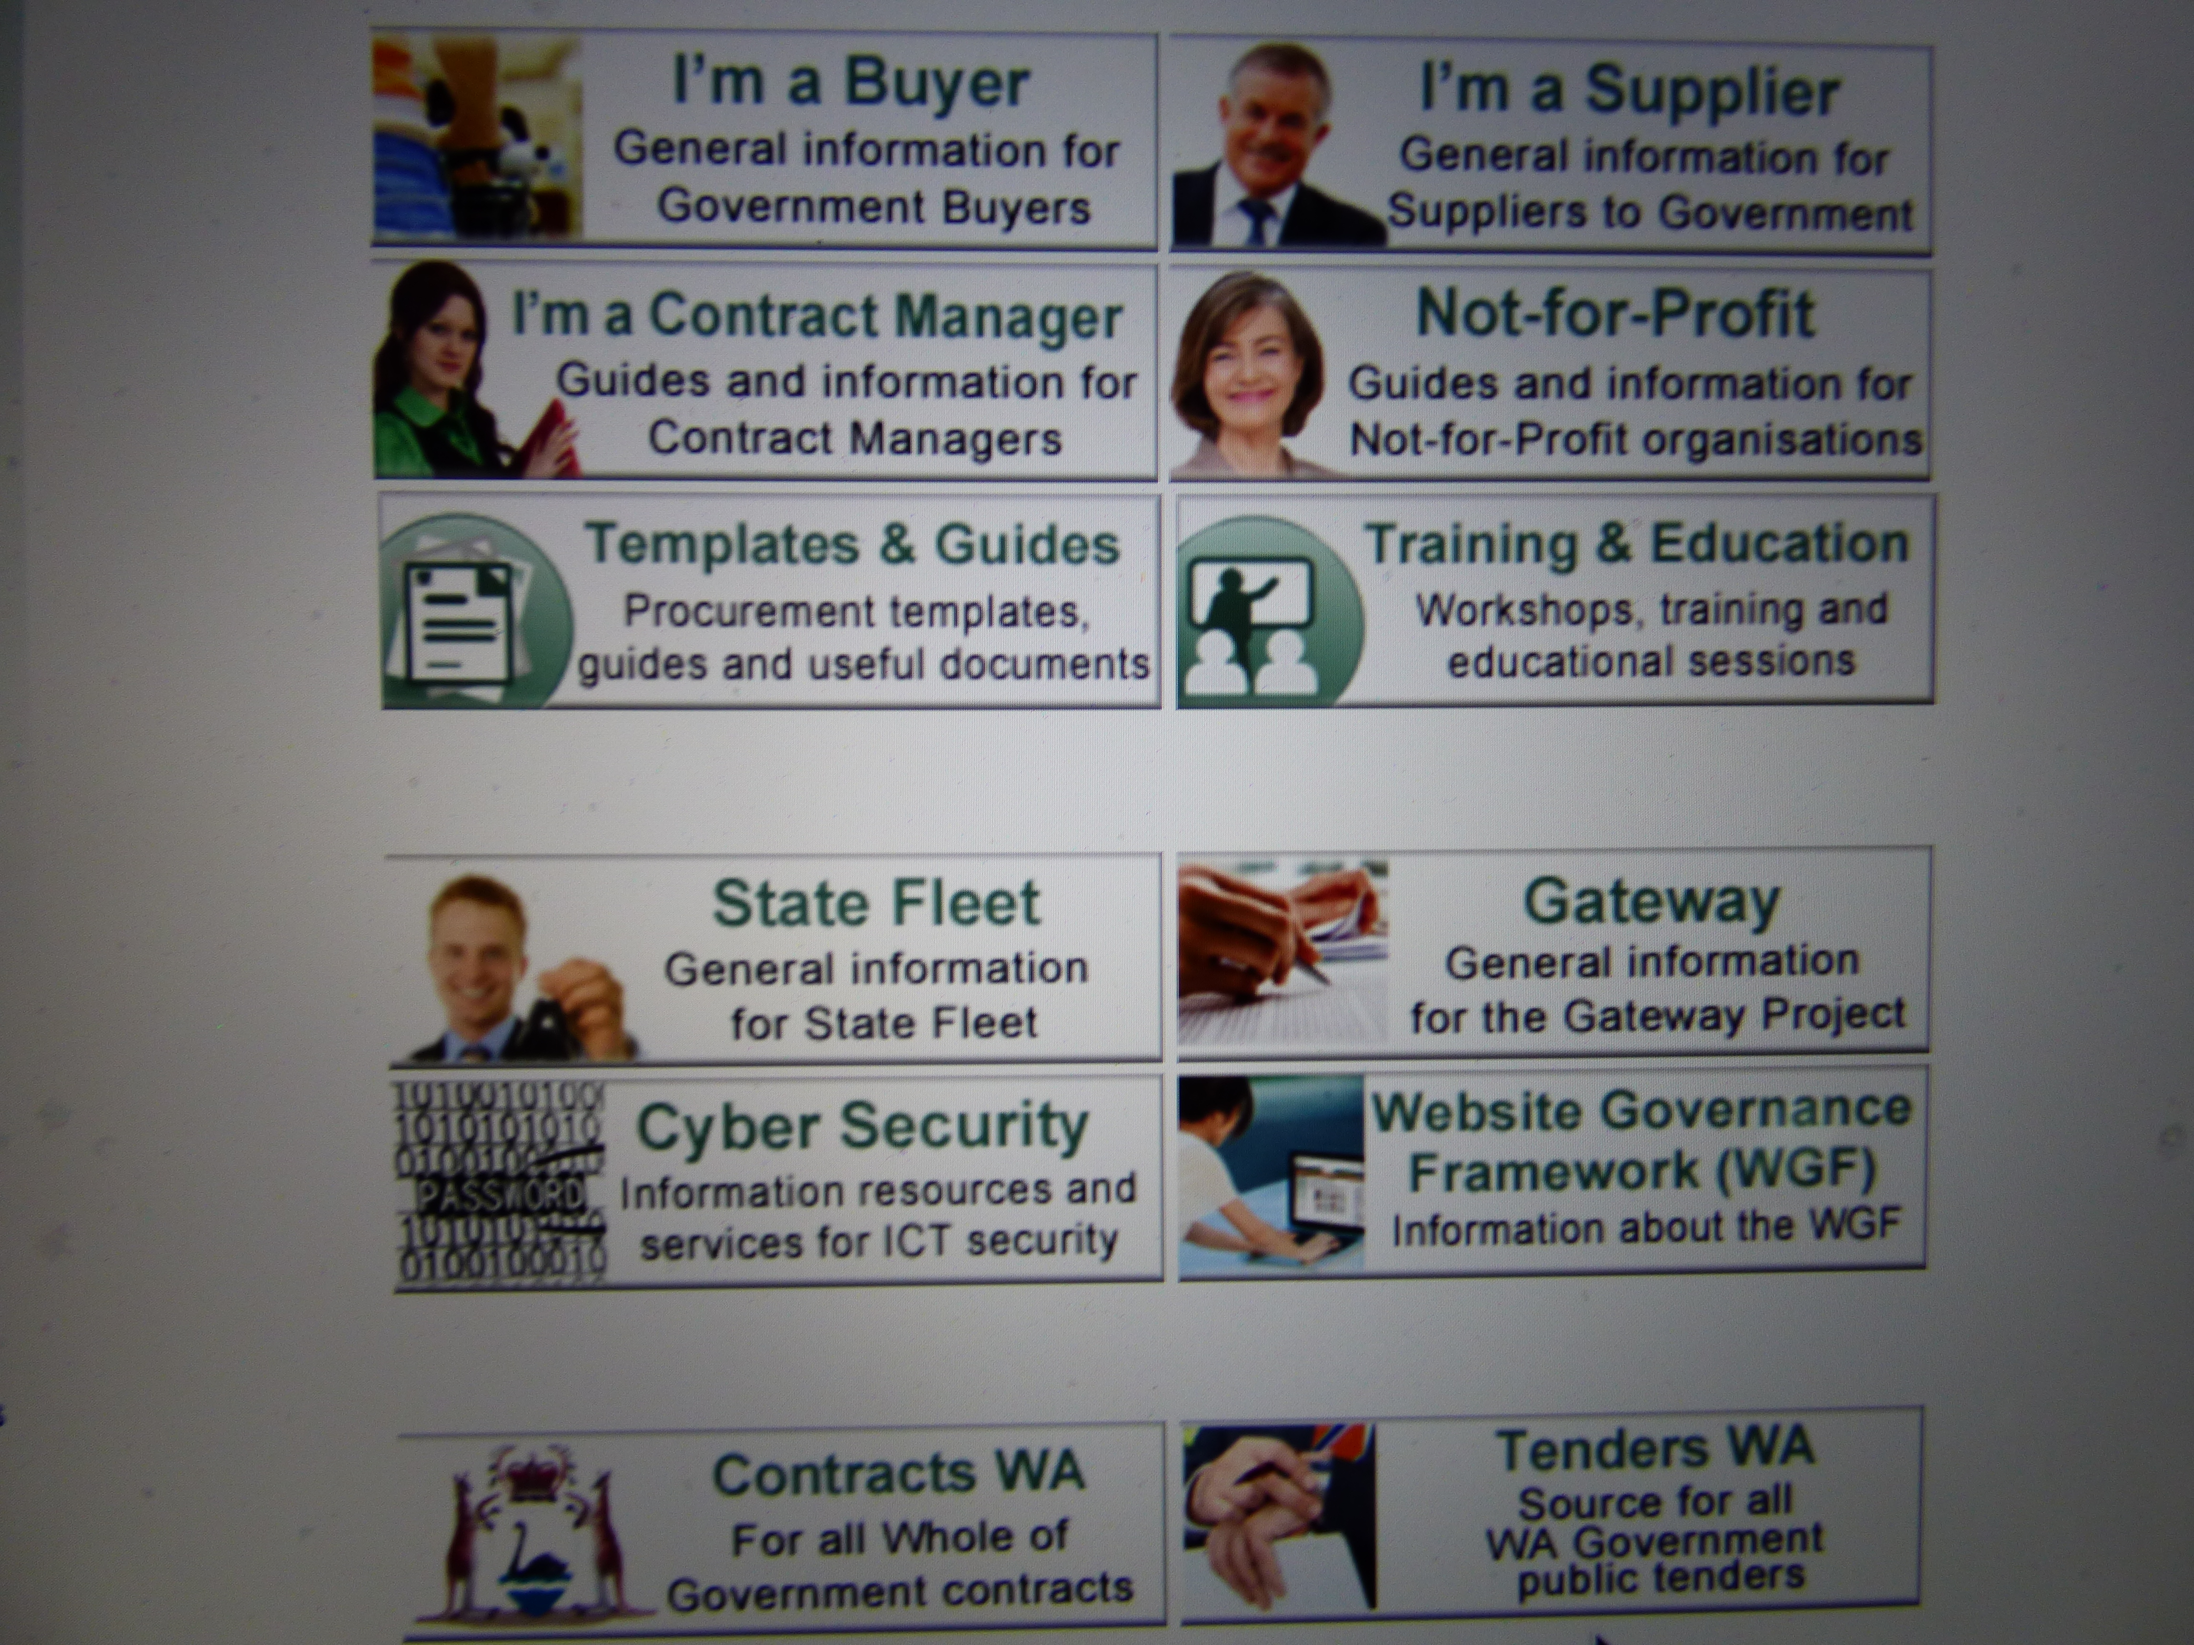
Example: e-Procurement Website www.finance.wa.gov.au/governmentprocurement

Slide 8

How Systems make e-GP Effective -1
They provide reliable, cumulative information-system generated from procurement cycle, or incorporated from other sources
  Procurement research and planning
  Procurement performance
  Audit – compliance and performance
  Reduced opportunities for corruption
They improved process efficiency, consistency, access, integrity
  System based processes
  Better use of Govt resources- from process
to management
  Reduced costs/time for bidders
  Secure e-transactions
  Reduced opportunities for corruption
Notes:
Time is right
At least 6 Caribbean countries ( Jamaica, Barbados and 4 in the OECS) are approaching the system specifications, acquisition and implementation stage for an e-procurement system. OECS harmonisation projects-e.g. e-procurement and e-enabling legislation (ensure all have same e-signature technology)
CARICOM is demonstrating that regional planning may work.
economic planning has made progress on Draft Framework Regional Integration Policy for Public Procurement June 2010. Covers principles, economic agreements, procurement procedures, institutional requirements and safeguards.
Associated e-Planning Strategies to harmonise ICT and e-Government harmonisation
CSME objective of free movement of goods and services will be assisted by a single e-procurement system. e.g. single item catalogue
CSME can not be achieved without regional government procurement.
Community and International Donor pressure building on governments to take action. Demand for better government services and accountability.
Significant benefits can be achieved

Slide 9
How Systems make e-GP Effective - 2
They lead to higher buyer and supplier satisfaction with the procurement process
  System based questionnaires available, recording of complaints
  More efficient and timely process
  Better access to information
They enable more effective application of policy and legislation
  Policy/legislation well transmitted to stakeholders
  Policy/legislation compliance and outcomes
  monitored , measured and reported
Notes:
Time is right
At least 6 Caribbean countries ( Jamaica, Barbados and 4 in the OECS) are approaching the system specifications, acquisition and implementation stage for an e-procurement system. OECS harmonisation projects-e.g. e-procurement and e-enabling legislation (ensure all have same e-signature technology)
CARICOM is demonstrating that regional planning may work.
economic planning has made progress on Draft Framework Regional Integration Policy for Public Procurement June 2010. Covers principles, economic agreements, procurement procedures, institutional requirements and safeguards.
Associated e-Planning Strategies to harmonise ICT and e-Government harmonisation
CSME objective of free movement of goods and services will be assisted by a single e-procurement system. e.g. single item catalogue
CSME can not be achieved without regional government procurement.
Community and International Donor pressure building on governments to take action. Demand for better government services and accountability.
Significant benefits can be achieved

Slide 10
How Systems make e-GP Effective - 3
They support improved procurement planning and management
  Cumulative market, process and performance data available
  Management and reporting templates
  Ad hoc reports on issues can be generated
  Roles and responsibilities can be more closely monitored
  Provide data to support decisions, changes, sanctions
Notes:
Time is right
At least 6 Caribbean countries ( Jamaica, Barbados and 4 in the OECS) are approaching the system specifications, acquisition and implementation stage for an e-procurement system. OECS harmonisation projects-e.g. e-procurement and e-enabling legislation (ensure all have same e-signature technology)
CARICOM is demonstrating that regional planning may work.
economic planning has made progress on Draft Framework Regional Integration Policy for Public Procurement June 2010. Covers principles, economic agreements, procurement procedures, institutional requirements and safeguards.
Associated e-Planning Strategies to harmonise ICT and e-Government harmonisation
CSME objective of free movement of goods and services will be assisted by a single e-procurement system. e.g. single item catalogue
CSME can not be achieved without regional government procurement.
Community and International Donor pressure building on governments to take action. Demand for better government services and accountability.
Significant benefits can be achieved

Slide 11
What International Practice Tells Us - 1
Based on International surveys and experience in 20 countries e-procurement systems have:
Improved the use of information and process efficiency/transparency (supplier information sets, savings 5-15%)
Shifted focus and resources from process to better planning and management. Enabled the use of Framework Agreements , e-Auctions
Enabled better measurement of buyer and supplier satisfaction and its improvement (50 up to 85%)
Provided clear, accessible, public information on policy, procurement process and decisions
Provided data on effectiveness of MSME policies (e.g. participation rates)
Notes:
Time is right
At least 6 Caribbean countries ( Jamaica, Barbados and 4 in the OECS) are approaching the system specifications, acquisition and implementation stage for an e-procurement system. OECS harmonisation projects-e.g. e-procurement and e-enabling legislation (ensure all have same e-signature technology)
CARICOM is demonstrating that regional planning may work.
economic planning has made progress on Draft Framework Regional Integration Policy for Public Procurement June 2010. Covers principles, economic agreements, procurement procedures, institutional requirements and safeguards.
Associated e-Planning Strategies to harmonise ICT and e-Government harmonisation
CSME objective of free movement of goods and services will be assisted by a single e-procurement system. e.g. single item catalogue
CSME can not be achieved without regional government procurement.
Community and International Donor pressure building on governments to take action. Demand for better government services and accountability.
Significant benefits can be achieved

Slide 12
e-P Systems Role in Reducing Corruption
Avoids unnecessary projects, improves process and project transparency in planning and decision making
Assists standardisation of tender documentation, promotes a transparent bidding procedure
Increases tender competition, provides real time, auditable information, automation of tender process, reduced human interaction.
Better monitoring of contract execution and accountability with increased contract performance
Better, transparent and open procurement focused audits, more co-operation and data sharing between government agencies
Modified from Szymanski (2007)
Notes:
Time is right
At least 6 Caribbean countries ( Jamaica, Barbados and 4 in the OECS) are approaching the system specifications, acquisition and implementation stage for an e-procurement system. OECS harmonisation projects-e.g. e-procurement and e-enabling legislation (ensure all have same e-signature technology)
CARICOM is demonstrating that regional planning may work.
economic planning has made progress on Draft Framework Regional Integration Policy for Public Procurement June 2010. Covers principles, economic agreements, procurement procedures, institutional requirements and safeguards.
Associated e-Planning Strategies to harmonise ICT and e-Government harmonisation
CSME objective of free movement of goods and services will be assisted by a single e-procurement system. e.g. single item catalogue
CSME can not be achieved without regional government procurement.
Community and International Donor pressure building on governments to take action. Demand for better government services and accountability.
Significant benefits can be achieved

Slide 13
e-Procurement Systems - Caribbean Area
Country | e-Procurement System | Status
Barbados | Proactis | Development in progress
Brazil | Comprasnet | Since 2000
Chile | Compranet | Since
Columbia | ? | ?
Costa Rica | Mer-Link (KONEPS) | Since 2009
Jamaica | European Dynamics | Contract awarded
Mexico | Compranet Plus | Since 1995 new version 2009
OECS (6-11) | European Dynamics | Established 2013. Had pooled procurement in pharmaceuticals
Panama | PanamaCompra | Established 2009
Peru | Tenders Info | Established 2013?
Notes:
Time is right
At least 6 Caribbean countries ( Jamaica, Barbados and 4 in the OECS) are approaching the system specifications, acquisition and implementation stage for an e-procurement system. OECS harmonisation projects-e.g. e-procurement and e-enabling legislation (ensure all have same e-signature technology)
CARICOM is demonstrating that regional planning may work.
economic planning has made progress on Draft Framework Regional Integration Policy for Public Procurement June 2010. Covers principles, economic agreements, procurement procedures, institutional requirements and safeguards.
Associated e-Planning Strategies to harmonise ICT and e-Government harmonisation
CSME objective of free movement of goods and services will be assisted by a single e-procurement system. e.g. single item catalogue
CSME can not be achieved without regional government procurement.
Community and International Donor pressure building on governments to take action. Demand for better government services and accountability.
Significant benefits can be achieved

Slide 14
The Time is Still Right (a la 2011)
OECS, Jamaica, Barbados have implemented or are developing e-Procurement systems
CARICOM Regional Integration Policy for Public Procurement Protocol, Draft ICT and e-Govt. strategies
Legislation is being finalised in some countries
CSME free movement goods /services needs regional e-procurement (e.g. common process & item catalogues)
Community & financial pressure on governments for better services
Significant financial, resource and performance benefits are available
Notes:
Time is right
At least 6 Caribbean countries ( Jamaica, Barbados and 4 in the OECS) are approaching the system specifications, acquisition and implementation stage for an e-procurement system. OECS harmonisation projects-e.g. e-procurement and e-enabling legislation (ensure all have same e-signature technology)
CARICOM is demonstrating that regional planning may work.
economic planning has made progress on Draft Framework Regional Integration Policy for Public Procurement June 2010. Covers principles, economic agreements, procurement procedures, institutional requirements and safeguards.
Associated e-Planning Strategies to harmonise ICT and e-Government harmonisation
CSME objective of free movement of goods and services will be assisted by a single e-procurement system. e.g. single item catalogue
CSME can not be achieved without regional government procurement.
Community and International Donor pressure building on governments to take action. Demand for better government services and accountability.
Significant benefits can be achieved

Slide 15
E-GP Integration Strategy - 1
A Pragmatic implementation strategy to best use resources and achieve some outcomes in reasonable time and cost
Seek governments’ support and funding for the strategy
Resource a Regional Implementation Team
Select / join an existing, implemented, e-procurement system that meets international standards
Identify and benchmark potential benefits that may be achieved
Use an interim Procurement Policy and Legislation if required
Notes:
Time is right
At least 6 Caribbean countries ( Jamaica, Barbados and 4 in the OECS) are approaching the system specifications, acquisition and implementation stage for an e-procurement system. OECS harmonisation projects-e.g. e-procurement and e-enabling legislation (ensure all have same e-signature technology)
CARICOM is demonstrating that regional planning may work.
economic planning has made progress on Draft Framework Regional Integration Policy for Public Procurement June 2010. Covers principles, economic agreements, procurement procedures, institutional requirements and safeguards.
Associated e-Planning Strategies to harmonise ICT and e-Government harmonisation
CSME objective of free movement of goods and services will be assisted by a single e-procurement system. e.g. single item catalogue
CSME can not be achieved without regional government procurement.
Community and International Donor pressure building on governments to take action. Demand for better government services and accountability.
Significant benefits can be achieved

Slide 16
E-GP Integration Strategy 2
Agree the scope of a pilot of the e-procurement system and the procurement options/documentation to be used (International competition, Framework Agreements ?)
Pilot the e-system and measure all components of the pilot
Review the pilot in relation to system performance and technical support , user satisfaction, policy and legislation requirements, cross border issues and make the required changes
Move to a more regional approach to government procurement
Notes:
Time is right
At least 6 Caribbean countries ( Jamaica, Barbados and 4 in the OECS) are approaching the system specifications, acquisition and implementation stage for an e-procurement system. OECS harmonisation projects-e.g. e-procurement and e-enabling legislation (ensure all have same e-signature technology)
CARICOM is demonstrating that regional planning may work.
economic planning has made progress on Draft Framework Regional Integration Policy for Public Procurement June 2010. Covers principles, economic agreements, procurement procedures, institutional requirements and safeguards.
Associated e-Planning Strategies to harmonise ICT and e-Government harmonisation
CSME objective of free movement of goods and services will be assisted by a single e-procurement system. e.g. single item catalogue
CSME can not be achieved without regional government procurement.
Community and International Donor pressure building on governments to take action. Demand for better government services and accountability.
Significant benefits can be achieved

Slide 17
Functional Feasibility - One System
International systems cover the full, common procurement processes
Provide comprehensive data-better decision making, planning. management and monitoring of performance, regulation, market trends, sharing of information
One set of catalogues, process documentation, guides for users
Enables use of framework agreements, e-auctioning, on line evaluation etc.
Major systems with wide use are more likely to evolve technically and functionally
Notes:
Time is right
At least 6 Caribbean countries ( Jamaica, Barbados and 4 in the OECS) are approaching the system specifications, acquisition and implementation stage for an e-procurement system. OECS harmonisation projects-e.g. e-procurement and e-enabling legislation (ensure all have same e-signature technology)
CARICOM is demonstrating that regional planning may work.
economic planning has made progress on Draft Framework Regional Integration Policy for Public Procurement June 2010. Covers principles, economic agreements, procurement procedures, institutional requirements and safeguards.
Associated e-Planning Strategies to harmonise ICT and e-Government harmonisation
CSME objective of free movement of goods and services will be assisted by a single e-procurement system. e.g. single item catalogue
CSME can not be achieved without regional government procurement.
Community and International Donor pressure building on governments to take action. Demand for better government services and accountability.
Significant benefits can be achieved

Slide 18
Financial Feasibility – One System
One system is cheaper than 3 or 4-acquisition, implementations, technical support, training , management, changes, (e.g.. OECS Pharmaceuticals)
Good return on investment-proven benefits in cost/time reduction (5-15%), transparency, access to information, procurement credibility
Caribbean is a very small procurement market-need to aggregate buying power, operate efficiently
E-Procurement Systems market is mature - many proven systems available. System costs reducing now approx 600,000 USD
Reduced costs and risk in shared implementation and operation
Notes:
E-procurement systems can deliver sustainable benefits so represent low financial risk.
The Caribbean government procurement market is very small and governments pay a premium for this in higher prices, and high procurement process costs. Using a single e-procurement system has the potential to reduce prices and costs. The Pharmaceutical Procurement Service in 9 OECS countries has operated since 1986 and has achieved 37% savings by pooling procurement across the countries.
One system is far cheaper than 5-6 systems regarding implementation, maintenance, operation, training, support, further development, and overall cost of ownership.
Good return on Investment—savings of 10-40% in 14 countries surveyed in 2007 and 2009.
Proven benefits cost & time reductions, improved transparency integrity and consistency, buyer and supplier satisfaction, date for decision making and monitoring performance. Benefits to both the public and private sectors.
Proven stable product, the procurement process is similar worldwide and so are the systems that support it-a proven process and system support. Low risk of implementation, operation and maintenance
Mature supplier market, about 20-30 proven systems worldwide
Cost 5-8 million USD over 3-4 years
It would support the Caribbean Single Market Protocol in assisting cross border trade

Slide 19
Technical Feasibility - One System 1
E-Procurement systems are now a common technology-low risk
Most countries have supporting infrastructure, access to Internet, bandwidth, moderate cost of usage
E-procurement systems provide similar functionality worldwide, support a similar process, proven performance
Open standards and architecture interoperable with existing financial systems
Secure, separate country data, encryption of documents, e-tender box, authentication, authorised users
One system vendor-consistent service and support for system
Notes:
This is not bleeding edge technology!
In most countries current infrastructure /internet bandwidth and access with minor enhancement can accommodate the e-procurement systems. 10 Mbps up and down loading
e-procurement systems robust, secure, many proven systems available
e-Procurement systems similar in functionality as is the procurement process

Slide 20
Technical Feasibility –One System 2
Scalable to regional/country requirements, scope of work differences in procurement environment
One Data Centre is possible
Notes:
Interoperable with most financial systems with open architecture , data transfer possible with Smartstream
Scalable- technical issues to be resolved are similar at Regional and National levels, scope of work is the real difference.
High security encryption, electronic tender box, authentication
Provide comprehensive data for better decision making and monitoring compliance and performance
Can be hosted from a single data centre anywhere
One set of e-procurement administrators (changes, backup, security management)
One system can be tailored for each country and will be seamless to the user.

Slide 21
Managerial Feasibility – One System 1
Systems do drive change – consistent process, improved transparency, reduces opportunity for corruption, greater access to opportunities for suppliers, reduced costs
Standardises and simplifies the procurement process –SBDs, template docs, procurement catalogues, e-document transfer
Enable wider application of procurement staff away from the process to planning and management *
  Similar e-GP support components required- policy, legislation, regulation in common law countries, therefore harmonisation is possible
Notes:
E-procurement systems in themselves are key drivers of government procurement modernisation by introducing increased access to opportunities, providing a transparent, consistent and auditable process, change of behaviour, skills development and providing accessible data for better decision making and monitoring and reporting of the performance of government procurement.
Procurement process is universal and can be standardised
Common Standard Bidding Documents can be created or applied
Similar support components. The policy, legislation, regulation, training are very similar in common law countries, therefore harmonisation is possible
Common training and education requirements-the most expensive and time consuming support requirement.
Comprehensive data is available for better decision making and monitoring compliance and performance and data can be logically and securely partitioned for each country and agency level
Assists the to be formed Central procurement Agency to manage WOG procurement, centralise Country procurement
Support pooled procurement and Framework Contract buying

Slide 22
Managerial Feasibility – One System 2
  Reduces costs, time required for procurement processes
  Improves transparency, consistency and supplier and buyer satisfaction
  Common training/education programs- cheaper, better
  Comprehensive data for decision making, performance monitoring and regulation, providing comparative data
  Assists new efficient centralised procurement- pooled procurement, framework agreements

Slide 23
Key Issues to be Addressed
Political - what cost?, lose control? MSMEs will suffer, exposure of current practices, harmonisation take too long. The Real issues are:
Currently little data on country procurement performance, transparency, market trends/issues
Local procurement process often discretionary, extended credit may shape relationships
Little policy implementation to raise participation of MSMEs in procurement
Under resourced central procurement mgt. agencies to drive reform
Observed low readiness on training, policy, procurement management, standards, private sector involvement
Notes:
Political- A regional e-procurement system may disadvantage the smaller Island economies, by opening up the market and exposing our small businesses to competition from big companies. Politically there are issues of upsetting small and large business and far greater public scrutiny of government procurement.
THE POLITICAL ISUES CAN BE MANAGED IF GOVERNMENTS DEAL WITH THE REAL PROBLEMS IN A SYSTEMATIC WAY. The real problems to be addressed are:
Lack of data on government procurement on which to plan and make decisions
Lack of small business policy to encourage participation in the government market
Lack of resources in many countries to have a sponsored, resourced, central procurement management agency to co-ordinate, develop and implement the support required for small business.
The need for procurement awareness and training for suppliers
The need for governments to pay on time so small business is not disadvantaged and competition can be widened.
Generally low readiness levels on human resource development, process management, policy, regulation, standards (technical, procurement and management), and private sector involvement will delay implementation of systems
Understanding that outsourced services and system administration that may be outside a country do not represent loss of National control of the procurement process
Lack of a regionally agreed protocol on government procurement and procurement threshold levels.
Difficulty of investing in the future when it is hard to service current needs
Governments are wary of increased scrutiny by the public

Slide 24

Thank you
QUESTIONS ?
David McDermont

Slide 25
Some Selected References
Role Of Public E-procurement Technology To Reduce Corruption In Government Procurement 2012 International Public Procurement Conference, August 17-19, Seattle, Washington, Neupane, Soar, Vaidya, & Yong
IGS Documents developed for the MDBs (see www.mdbegp.org )
E-Tendering (System) Requirements for MDB Financed Procurement 2005
International Survey of E-Procurement Systems 2007 and 2009
Electronic Government Procurement (e-GP) Readiness Self Assessment (Revised 2009
Notes:
Political- A regional e-procurement system may disadvantage the smaller Island economies, by opening up the market and exposing our small businesses to competition from big companies. Politically there are issues of upsetting small and large business and far greater public scrutiny of government procurement.
THE POLITICAL ISUES CAN BE MANAGED IF GOVERNMENTS DEAL WITH THE REAL PROBLEMS IN A SYSTEMATIC WAY. The real problems to be addressed are:
Lack of data on government procurement on which to plan and make decisions
Lack of small business policy to encourage participation in the government market
Lack of resources in many countries to have a sponsored, resourced, central procurement management agency to co-ordinate, develop and implement the support required for small business.
The need for procurement awareness and training for suppliers
The need for governments to pay on time so small business is not disadvantaged and competition can be widened.
Generally low readiness levels on human resource development, process management, policy, regulation, standards (technical, procurement and management), and private sector involvement will delay implementation of systems
Understanding that outsourced services and system administration that may be outside a country do not represent loss of National control of the procurement process
Lack of a regionally agreed protocol on government procurement and procurement threshold levels.
Difficulty of investing in the future when it is hard to service current needs
Governments are wary of increased scrutiny by the public

